Slide 1
PARALLEL COMPUTING
Multivariable Gradient Descent Optimization

Slide 2
What is Gradient Descent?
Gradient descent is a first-order iterative optimization algorithm.
Given a function defined by a set of parameters, gradient descent starts with an initial set of parameter values and iteratively moves toward a set of parameter values that minimize the function.
This iterative minimization is achieved using calculus. Taking steps in the negative direction of the function gradient and finding the minimum.

Slide 3
Visualisation of Gradient Descent

Slide 4
Different types of Gradient descent methods
Batch Gradient descent
Stochastic Gradient descent
Mini-batch Gradient descent

Slide 5
Batch Gradient descent
The Batch gradient descent will use all variables in each iteration to try to find the minimum.

Slide 6
Stochastic Gradient descent
The Stochastic gradient descent uses one variable in each iteration to try to find the minimum.

Slide 7
Mini-batch Gradient descent
The mini-batch gradient descent uses a size on variables somewhere between the batch gradient descent sizes and stochastic sizes in each iteration.

Slide 8
Chosen Gradient descent method
Stochastic gradient descent (SGD) optimization is the most efficient and most common in fields of science and engineering.
Gradient descent algorithm evaluates at different points of data. By taking gradient steps at each point of data, along with related sub functions optimization can be made more efficient.

Slide 9
The ability of the SGD to average gradients over an amount of space which avoids doing one big calculation for the optimal descent or big chunks of calculations is why it is efficient.
It doesn’t over look spaces that would be missed by the bigger calculation methods and is detailed enough to get all local maxima/minima.

Slide 10
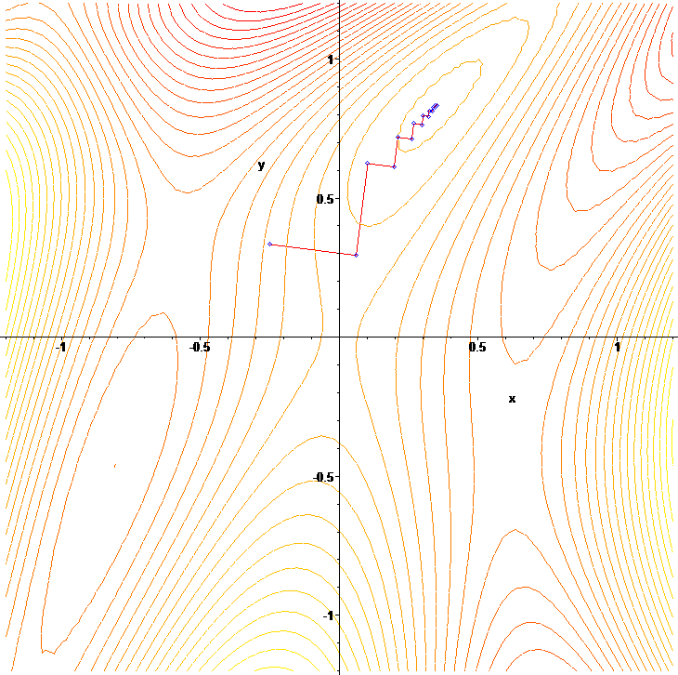
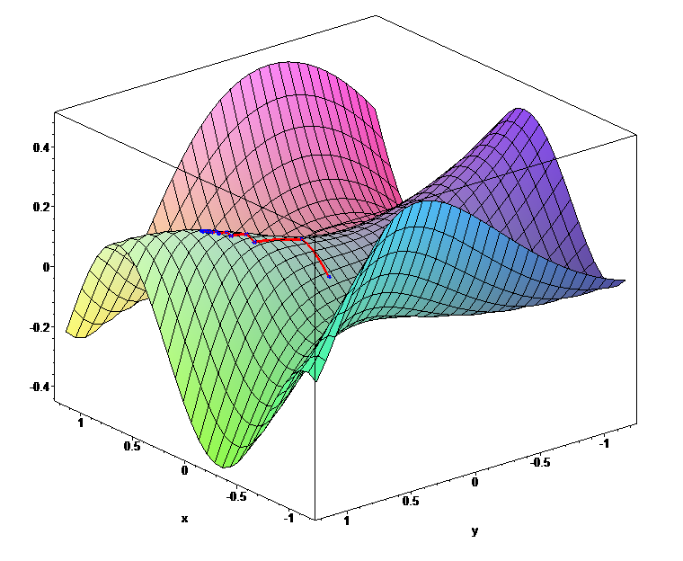
Image of Gradient Descent (contour)
Image of Gradient Descent (surface)

Slide 11
Stochastic VS Batch or Mini-batch Gradient descent
Stochastic gradient descent computes the gradient using a single sample from the dataset. It works better on more uneven/manifold functions that have lots of local maxima/minima. The different gradients that will be calculated over the different data points are what help draw the algorithm out of the local minima into a region that hopefully is more optimal every time.

Slide 12
Batch gradient descent computes the gradient using the whole dataset and this is great for mainly convex or relatively smooth functions. This will give straightforwardly optimum solution.

Slide 13
Applications
Stochastic gradient descent optimization is a popular algorithm in:
training a wide range of models in machine learning
logistic regression
graphical models
training artificial neural networks

Slide 14
Limitations
The asymptotic rate of convergence of gradient descent causes the algorithm to be slow close to minima. It “zigzags” more as the gradients point to the minimum point.
All functions that can be optimized using gradient methods are differentiable, non-differentiable functions cannot be optimized.

Slide 15
Additional Stochastic Gradient descent algorithms
Momentum
Nesterov accelerated gradient
Adagrad (Adaptive Gradient Algorithm)
Averaging
RMSprop
Adam

Slide 16
Visualisations of SGD algorithms
The mentioned algorithms are just algorithms which try to speed up the normal stochastic gradient descent algorithm.

Slide 17
Contours

Slide 18
Surface

Slide 19
Stochastic Gradient Descent algorithm
SGD Samples X={x0, x1, x2,......, xm}, Iterations T, steps size є and states w
Require є > 0 1: choose initial wt 1: for T = 0...m do 2: pick i ∈ {1…..m} uniformly at random 3: update wt + 1⇽ wt - ε xi Qw (wt) 4: return wt

Slide 20
Right now
Testing various Multivariable Gradient Descent codes in c and c++ to see if the initial code before parallelisation works
Next
Looking at different parallelisation methods and techniques that will work best with our algorithm
…

Slide 21
Thank You

